Slide 1
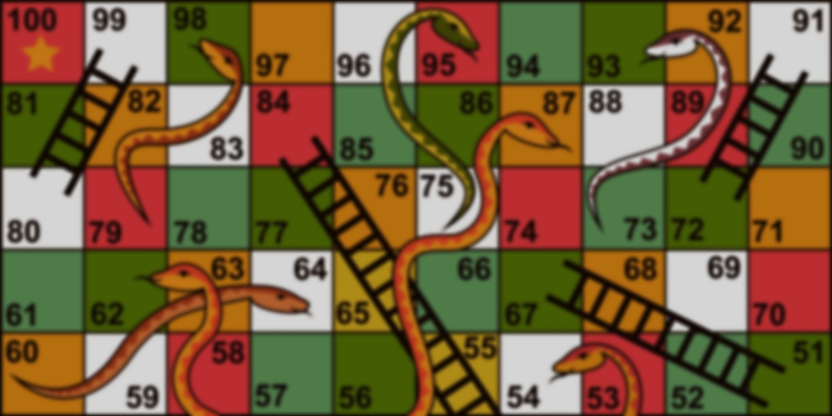
NETWORK
SNAKES
AND
LADDERS
LET’S HAVE A GAME !
Username
Password

